Slide 1
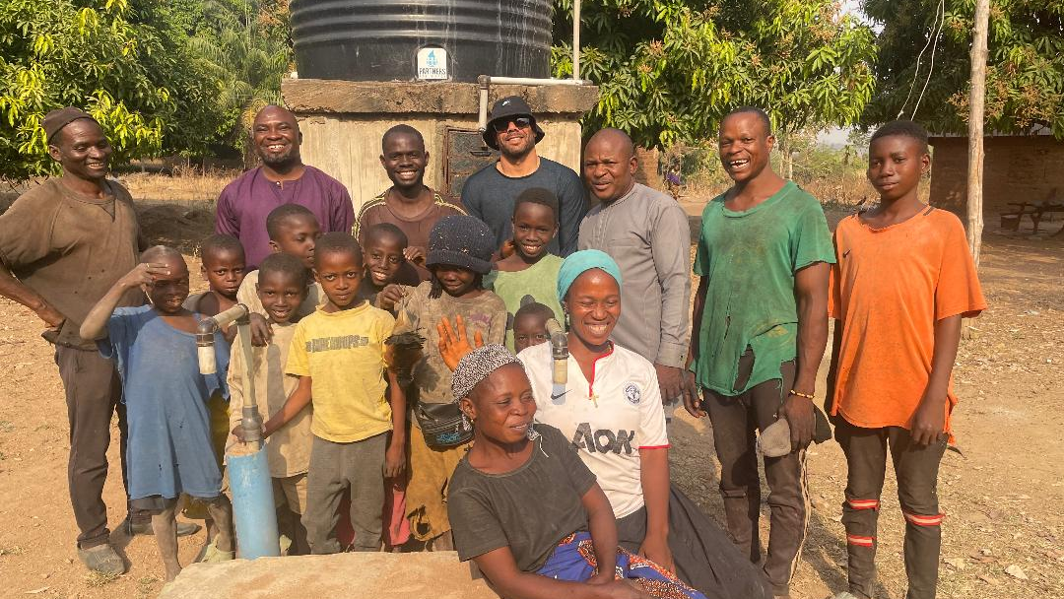

Partners For Water
2024 Annual Report

Slide 2
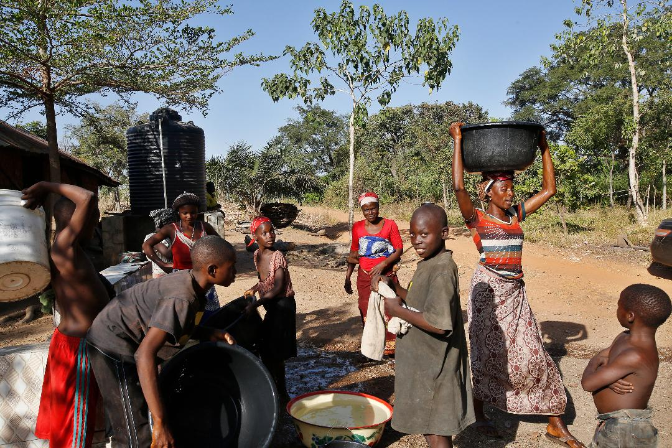
2024 saw are project total surpass 40 completed projects. These projects now bring safe and accessible water to 34,787 each day.
Because our oldest projects are now six years old, we have expanded our efforts to borehole maintenance. This expansion of efforts are essential to make sure that we continue to serve as many people as possible.

Slide 3
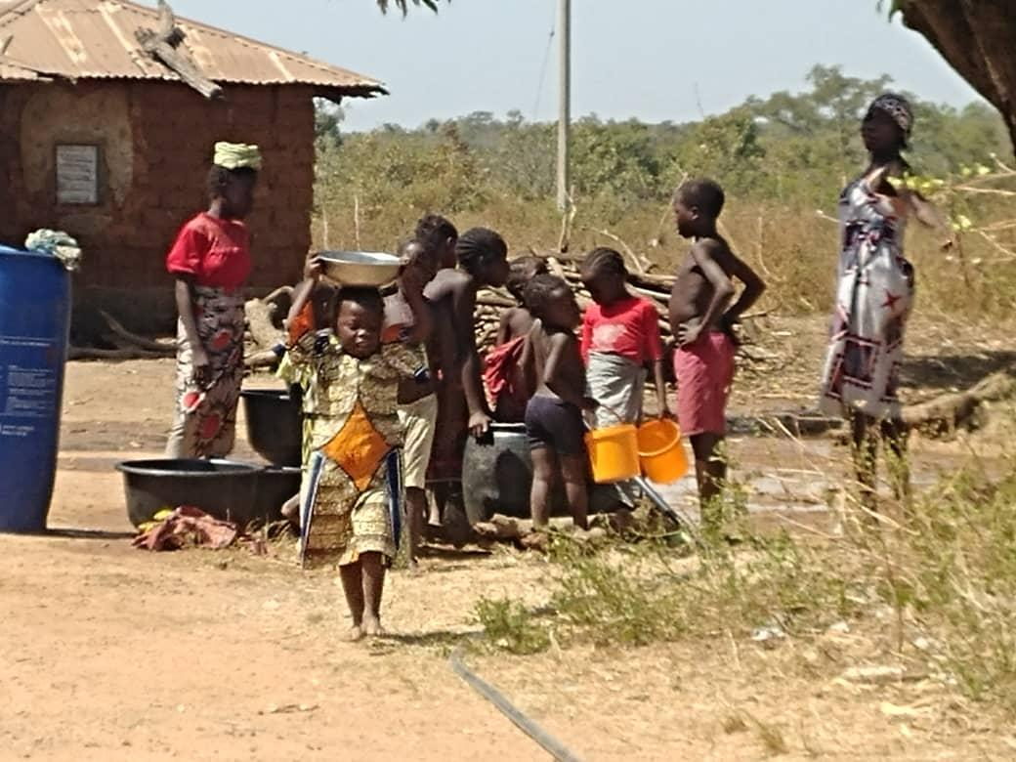
Projects Completed: 4
Duduguru Community, Nasarawa State, Nigeria
Angwan Ongre-Zi, Akun Development Area
Angwan NACABS, Wamba Bypass, Akwanga
Angwan Busha Community, Karu LGA

Slide 4
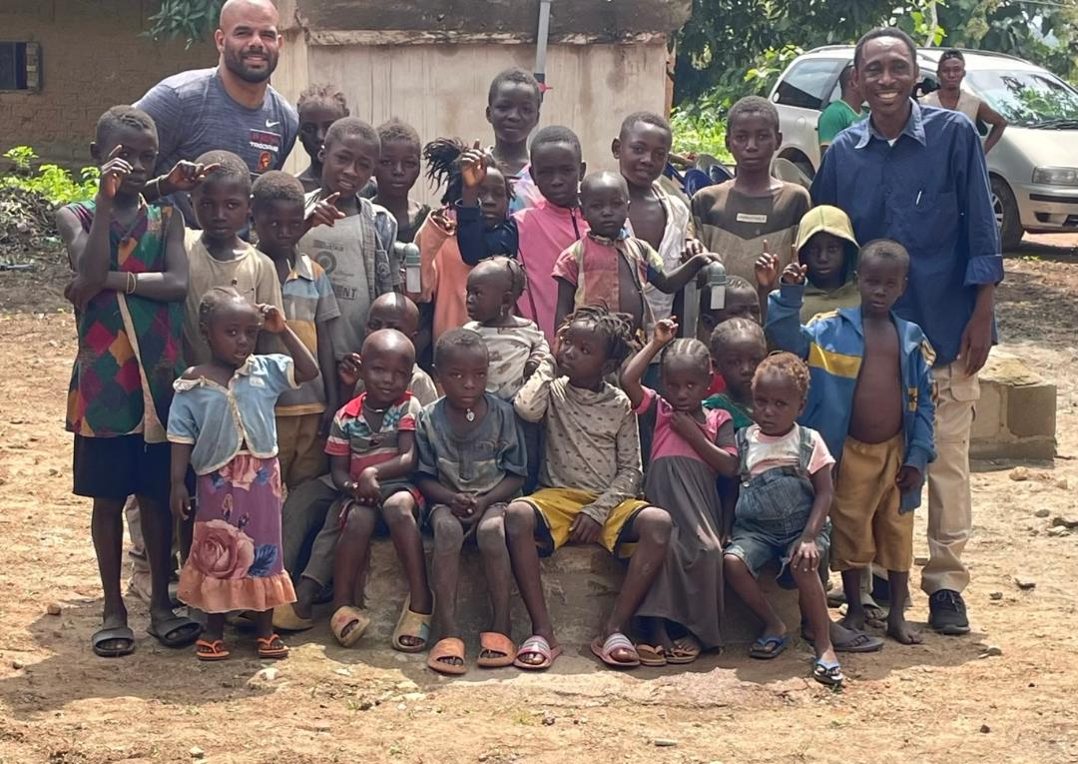
Project Cost & Community Population
Duduguru Community, Nasarawa State, Nigeria
  Population: 2225
  Project Cost: $5,574.00
Angwan Ongre-Zi, Akun Development Area, Nasarawa State, Nigeria
  Population: 790
  Project Cost: $5,485.00
Angwan NACABS, Wamba Bypass, Nasarawa State, Nigeria
  Population: 550
  Project Cost: $5,114.00
Angwan Busha Community, Nasarawa State, Nigeria
  Population: 2260
  Project Cost: $5,579.00

Slide 5
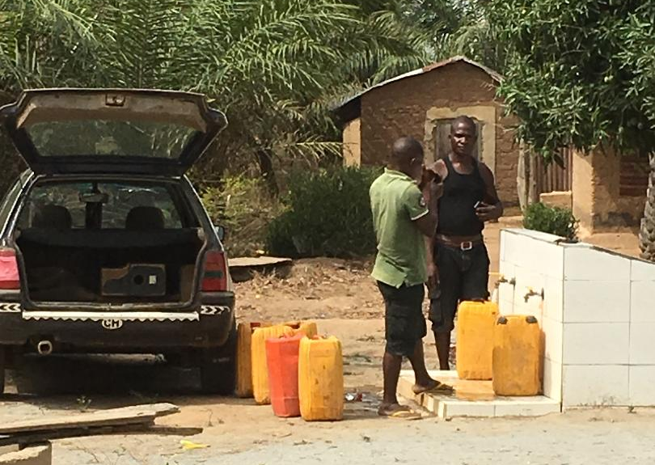
Financial
Fundraisers & Donations: $32,058.79
Expenses & Water Project Costs: $30,474.42
Percentage of Income Spent on Water Projects: 68%

Slide 6
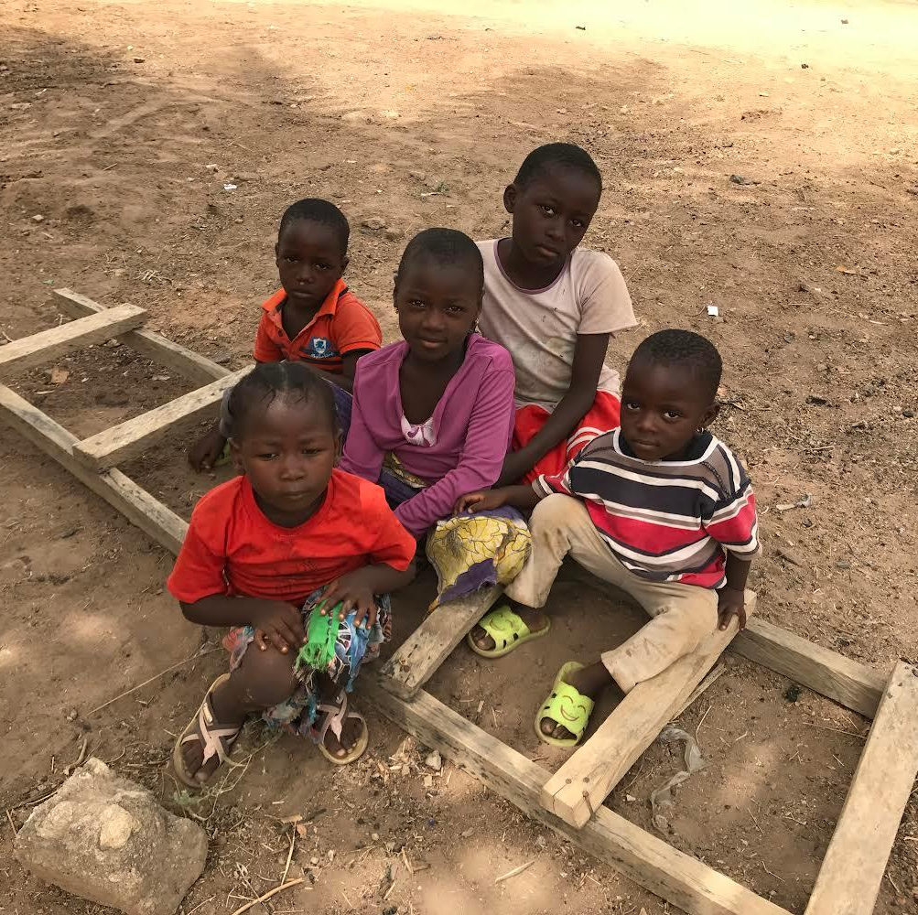
Our partner NGO in Nigeria experienced a significant leadership challenge in 2024. While continuing in our mission we will also be focused on assisting Chuga and Friends Foundation (CFF) in addressing this challenge in 2025.

